Slide 1


Slide 2
Catalog:
I、Overview
1.General Rules ………………………………01
2.Matters need attention ……………………02
3.Danger …………………………………… 03
I、Direction for use
1.Charging operation ………………………… 04
2.Start to run ……………………………………09
3.Lighting control ………………………………14
4.Other controls ………………………………16
5.Matters relating to the safe use of vehicles … 19
IV、After-sales service and maintenance
1.Scope and term of the Repair, replacement
and return ………………………………… 27
2. Does not belong to the repair, replacement,
and return ……………………………………34
3.Repair and maintenance instructions ………… 36
4.Routine maintenance code ………………… 38
5.Unconventional maintenance specification … 43
6.Common problems and solutions ……………45
7.Warranty card ……………………………… 48
Ⅲ、Vehicle parameters
1.Main forms, parameter types and
parameter values of charging machine,
charging plug and socket ……………… 22
2. Drive motor main parameters and
performance indicators …………………… 23
3.Power battery system assembly main
types and parameters ……………………24
4.Main parameters of vehicle ……………… 25
5.Tire inflation pressure (cold state) ………… 26
6.Other parameters ………………………… 26

Slide 3
I、Overview
1.General Rules
1) This vehicle is a pure electric four-wheeled vehicle, and its operation and characteristics are different from those of traditional fuel vehicles. Therefore, please read this manual carefully before using the vehicle.
2) The car is driven by electric energy. The car battery, located inside the front seat cylinder, provides driving power for the vehicle, and provides power for the instrument, lights and corresponding control modules.
3) If the battery uses 60V, please ask professional maintenance personnel to install the
charging line for you.The AC charging line must be properly grounded and installed with the main switch and leakage protection device.
4) Please don't touch the cable on the car.
5) After picking up the car, please charge the battery to 100% in time before it is less than 30%, so as to maintain the power battery.
6) The final interpretation right belongs to the Company.In case of any change, the latest release of the Company shall prevail.
01

Slide 4
I 、Overview
2. Matters need attention
1) The electrical equipment on the car is divided into low-voltage electrical equipment and
high-voltage electrical equipment. The rated working voltage of the low-voltage electrical equipment is 12V. These equipment include: sound, lighting, speakers, etc.; High voltage electrical equipment includes: drive motor, motor controller, power battery pack,voltage converter(DC/DC),charger,etc.
2) Caution To avoid electric shock, do not touch high-voltage components, high-voltage cables, and their connectors.
3) Do not touch exposed or damaged cables. Otherwise, personal safety risks may arise.
4) It is forbidden to disassemble or change the electric equipment on the vehicle, otherwise it may cause short circuit, burn and fire and other serious consequences.
5) In case of vehicle accident: if time permits, turn off the vehicle power, start the parking brake, turn on the double flash, place the triangle warning plate , then leave the vehicle and finally contact the service center immediately. If time does not permit, such as fire or strong burning odor, please immediately turn off the vehicle power, enable parking brake and then stay away from the vehicle.
02

Slide 5
I 、Overview
2. Matters need attention
6) In case of fire or smoke: immediately turn off the power and get off the vehicle. If the fire is large or developing rapidly, get away from the vehicle immediately and call the local fire alarm number. If the fire is small, use extinguishing equipment to extinguish the fire and keep an adequate safe distance from the source of the fire.
7) If you need to replace the battery, please be sure to send the old batteries to NWOW
authorized service center for recycling. Discarding power batteries will pollute the
environment and even cause personal injury. Relevant laws and regulations also require this kind of waste to be recycled and disposed of.
3.Danger
1) Do not modify the charging port and charger, otherwise it may cause charging failure or even fire. Do not remove the battery pack without permission. Do not cut or hit the
power battery pack when handling the accident. Otherwise, the power battery pack may leak or distort, which may cause injury to personnel.
03

Slide 6
Ⅱ 、Direction for use
1.Charging operation
1) Charging matters Charging operation
a) Park the vehicle in a ventilated place, and do not stay in the vehicle while charging.
b) When charging at home, the charging system will continue to charge the vehicle if there is a power failure and the power comes back.
c) Before driving, ensure that the charger is disconnected from the vehicle, the charging cable is collected, and the charging port cover of the vehicle is closed.
d) Under the circumstances of different power battery capacity, vehicle electric capacity, ambient temperature and different charger power, the full charge time may have a
certain deviation, which is a normal phenomenon. When the ambient temperature is high, the charging efficiency decreases and the charging time is longer. It is
recommended that the ambient temperature during charging be carried out in the morning and evening. Try to avoid charging in high temperature environment uch as direct sun.
04

Slide 7
Ⅱ 、Direction for use
1.Charging operation
2) Judgment method for vehicle charging
a) If conditions permit, it is recommended that you charge your vehicle when you park it. Shallow charging and shallow discharging of the battery is beneficial to prolong the battery life. Don't wait until the battery is dead to recharge. This may not be good for your next trip or your battery life.
b) If the meter shows low power level during the vehicle running, it indicates that the
power battery is insufficient and the discharge capacity of the power battery is greatly weakened. In this case, stop driving and charge the vehicle as soon as possible.
c) When the meter shows that the remaining power is small, or the driving range cannot meet the travel demand, it must be charged. Try to avoid charging in high temperature environment such as direct sun.
05

Slide 8
Ⅱ 、Direction for use
1.Charging operation
3) Charging power supply requirements
a)The charging system of this car uses ordinary household AC power supply: voltage: 220V. Ensure that the load of the power supply line meets the requirements of the charger.If
the power supply line consists of multiple lines, the wires, plugs, and sockets on each line must meet the load. Otherwise, parts that cannot meet the load may overheat and melt or catch fire.
b) When household electric power is used for charging, a master switch and a leakage protection switch should be installed at the front end of the charging line, so that the master switch can be disconnected and leakage protection can be carried out in an emergency. The ground cable must be properly grounded.
06

Slide 9
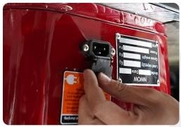
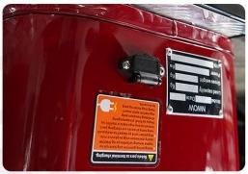
Ⅱ 、Direction for use
1.Charging operation
4)Charging operation
The position of the vehicle charging port is shown in the picture on the right. Connect oneend of the charger to the mains socket and the other end to the charging port. When thecharger turns to a red light, the vehicle will start charging. When the charger turns green,the vehicle charging is complete.
07

Slide 10
Ⅱ 、Direction for use
1.Charging operation
5) Dangerous
Before charging, make sure that there is no water or other substance in the charging port or charging connection icon port of the charger end. If there is, charging is not allowed. Otherwise, short circuit or electric shock may occur, resulting in personal injury and
property damage. Do not touch the metal parts of plugs and other connectors while
charging. Water can conduct electricity. When charging, do not touch the charging cable and plug with wet hands. Do not touch the charger in an excessively humid environment,
otherwise it may be electrocuted. If odor or smoke is emitted during charging, stop
charging immediately and contact the service center in time. Don't charge in lightning weather, and don't charge in the open on rainy days. Otherwise, the charger may be damaged, or lightning or electric shock may occur.
08

Slide 11
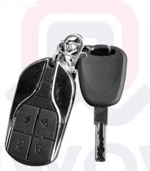
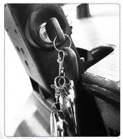
Ⅱ 、Direction for use
2.Start to run
1)Enable the vehicle to enter the power-on state
=Lock key
=Unlock key
=Car finder key
=Button start
As shown in the picture, first use the remote control electronic key to unlock the vehicle, then switch the key switch to ON, and the instrument light will be lit.
09

Slide 12
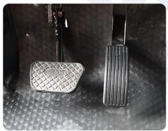
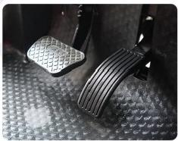
Ⅱ 、Direction for use
2.Start to run
2) Brake and throttle
In the figure, the left side is the brake pedal, the right side is the accelerator pedal, and the hand brake device is above.
Parking state
Non-parking state
10

Slide 13
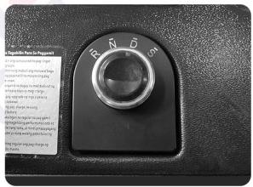
Ⅱ 、Direction for use
2.Start to run
3) Shift release handbrake start
Rotate the shift knob, choose D gear forward start or R gear reverse, pay attention to release the handbrake before driving. The current gear (R, N, D, S) is displayed on the instrument.(D gear is recommended))
R=Reverse gear shift N= Neutral gear shift D = Drive gear shift
S=Sports gear shift
11

Slide 14
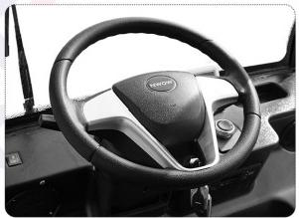
Ⅱ 、Direction for use
2.Start to run
4) Pedestrian warning device
Pure electric vehicles have low noise when driving, and the low-speed pedestrian warning system equipped with the vehicle can play a good role in alerting pedestrians.
When the vehicle starts or runs in the process, in case of danger or need to remind pedestrians and other vehicles, you can press the horn in the middle of the steering wheel to remind.
The warning system will work when the vehicle is in reverse, and the vehicle's pedestrian warning device will emit the "drip drip" sound of the reversing radar.
(The middle button is the horn switch)
12

Slide 15
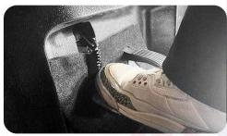
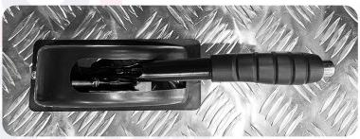
Ⅱ 、Direction for use
2.Start to run
5) Parking
Park the car in N gear, step on the foot brake, and Pull up the parking handle to complete the parking.
6) Steering wheel lock
When the key is removed, the steering wheel is locked, and the steering wheel can only rotate once. Insert the key and rotate to ON to unlock the steering wheel lock.
13

Slide 16
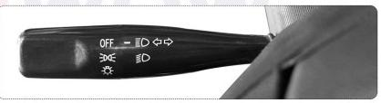
Ⅱ 、Direction for use
3.Lighting control
1) Lighting switch
OH =Allights are off
E =Dashboard, location light, license plate light
=Near light and all above lights on
ED=High beam and all above lights on (except near light)
Push the joystick towards the dashboard as shown to turn on the high beam. To switch back to near light, pull in the opposite direction. Overtaking light: When driving in the process of overtaking, you can quickly pull to the driver's seat direction twice, while the high beam will
quickly
flash twice.
14

Slide 17
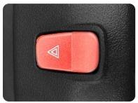
Ⅱ 、Direction for use
3.Lighting control
2) Double flash
Press the double flash switch.
(Located in front of the steering wheel)
3) Turn and lane change signals
Joystick up = right-turn indicator
Joystick down =left-turn indicator
At the end of the turn, return the joystick to its normal position and turn off the steering signal and instrument.
4) Reverse the headlights
When you rotate the shift knob and select R-shift, the rear two row taillight lights will turn on(white).
5) Brake lights
When the brake pedal is pressed or parked, the brake light will come on in the rear two rows of taillights and ceiling lights (bright red).
15

Slide 18
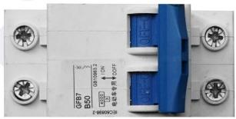
Ⅱ 、Direction for use
4.Other controls
1) Total switch control
When the vehicle will not be used for a period of time, the main switch can be turned OFF. At this time, the vehicle is powered off and cannot be used. Tip: If the vehicle needs
maintenance, it is necessary to turn off the main switch and wait for 10mins (or turn on the power to discharge off). When the maintenance is completed or before use, make sure that the key switch is in the OFF position before closing the main switch to the ON state.
Note:
During maintenance, do not touch the metal body with cables.
Otherwise, short circuit may occur and safety risks may arise.
16

Slide 19
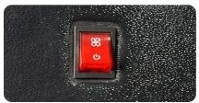
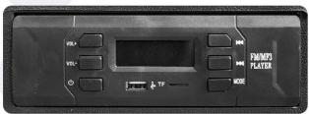
Ⅱ 、Direction for use
4.Other controls
2) Fan control
When the fan switch is turned on, the fan starts to work.
3) Radio and Bluetooth sound control
vo =Volume Up
me =Volume Down
=Radio/Bluetooth audio
W)=Switch to the previous song
CM =Switch to the next song
e =Mode switching, radio & Bluetooth
AD =USB charging port, mobile storage SD card
Tip: USB charging port 5V1A, can be used for mobile phone charging
17

Slide 20
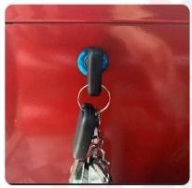
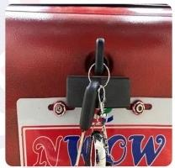
Ⅱ 、Direction for use
4.Other controls
4) Seat cushion storage box lock control
Turn to right to open the front seat cushion (glove compartment) lock. Before removing
the key, restore the seat cushion lock to the locking position.
Turn to the right to open the rear seat cushion (glove compartment) lock. Before removing the key, restore the seat cushion lock to the locking position.
18

Slide 21
Ⅱ 、Direction for use
5.Matters relating to the safe use of vehicles
1) Turn off the key switch when leaving the vehicle, and use the remote key to lock the vehicle, otherwise there may be a risk of theft.
2) After the driver leaves the vehicle, please do not store valuables in the car, otherwise the company will not be responsible for any loss of valuables.
3) Use the parking handle when parking. Please loosen the parking handle before driving. The use of non-designated or inferior oil will damage the vehicle.
4) Cigarette lighters, propane gas cylinders, perfume or other combustible/explosive
substances are not allowed on the vehicle. These items pose a safety hazard when the vehicle is exposed to high temperatures for a long period of time.
5) Do not expose light concentrating items in the car, such as glasses, magnifying glasses, etc, which may cause the risk of burning.
19

Slide 22
Ⅱ 、Direction for use
5.Matters relating to the safe use of vehicles
6) Don't wade. On the one hand, the vehicle can float out of control, and on the other hand, water entering the core components can lead to expensive repairs.
7) When the tire is punctured, control the direction and do not brake suddenly. Sudden braking will cause the vehicle to lean to one side, which may cause an accident.
8) Don't stick any part of your body out of the car while driving.
9) When driving, fix the articles on the car and remove all the articles that may hinder driving.
10) When driving, it is forbidden to put the container with liquid not tightly covered in the cup holder. If the liquid spills, it could burn you or create a distraction that could be a safety hazard.
11) Do not turn the key switch while driving. Otherwise, the steering wheel may be locked, causing the vehicle to lose control.
20

Slide 23
Ⅱ 、Direction for use
5.Matters relating to the safe use of vehicles
12) Be sure to use the specified specifications of tires and wheels. Using other specifications of tires or wheels may cause the relevant parts of the vehicle to work improperly or even cause accidents.
13) lf the vehicle needs traction, please contact the service center for handling. Passengers are not allowed to sit in the car and exceed the safe speed limit. Do not remove the key from the ignition or it will lock the steering wheel.
14) When approaching the coming vehicle or approaching the vehicle in front (driving at night), the high beam should be switched to the near light. High-beam headlights can temporarily blind other drivers, potentially causing a collision.
15) Do not leave unattended children or pets in the car, or it may cause safety hazards.
21

Slide 24
Ⅲ 、Vehicle parameters
1.Main forms, parameter types and parameter values of charging machine, charging plug and socket
 | Standard options | Battery life version | lithium battery
Model | 60V45A | 60V45A | 60V45A
Charging socket | National standard flat two holes | National standard flat two holes | National standard flat three holes
Charging plug | One horizontal two vertical product shape | One horizontal two vertical product shape | 2 plus 4
22

Slide 25
Ⅲ 、Vehicle parameters
2.Driving motor main parameters and performance indicators
 | Standard options/Battery life version/lithium battery
Mode | 60V1200W
Handpiece | 18Skewed tooth
Magnetic steel | 40*3Tile magnetic steel
23

Slide 26
Ⅲ 、Vehicle parameters
3.Power battery system assembly main types and parameters
 | Battery life version (selective assembly) | ithium battery (selective assembly)
Model | 60V45AH | 60V45AH
Type | (Lead-acid battery) | lithium battery
Mile range | 55-60km | 55-60km
24

Slide 27
Ⅲ 、Vehicle parameters
4.Main parameters of vehicle
Model of unit | EMC-GOLF
Weight | 328kg(LEAD-ACID)/284.85kg(LITHUM）
Boundary dimension | 2400*1020*1740mm
Wheel base | 1560mm
Maximum speed | 25mile/hour
Grade ability | ≈8°
Maximum Load | 300kg
Front and back wheel base | Front and back 850mm
Minimum ground clearance | >100mm
minimum turning radius | <5m
Minimum braking length | <5m
25

Slide 28
Ⅲ 、Vehicle parameters
5.Tire inflation pressure (cold state)
Type of tire |  | Tire inflation pressure (full load), unit is:kPa
100/80-10 | Front tire | 230
 | Rear tire |  | 250
6.Other parameters
 | parameters
Brake pedal free-brake range distance | <30mm
Minimum scrap thickness of brake disc | 3mm(Start3.5mm)
New brake shoe friction lining thickness (standard) | 5mm
Minimum thickness of friction material (brake block/brake shoe) | 2mm/1.5mm

Slide 29
IV、After-sales service and maintenance
2.Does not belong to the repair, replacement, and return
12) Brake shoe, tires and other easily consumable products。
Attention
a)The batteries sold with the car have a recycling system, when the battery can not be used, do not throw away. Please return it to the dealership to protect the environment.
b) The above free service period is calculated from the date of purchase of the vehicle,and the fee beyond the "Repair, replacement and return" period will be paid by customer
himself/herself.
3.Repair and maintenance instructions
1) We suggest that you go to our authorized service center to maintain and repair your
vehicle, because only our authorized service center knows your electric vehicle best, you will be able to get pure accessories and professional technical services in our authorized service center, quality assurance can only be achieved in our authorized service center.
36

Slide 30
IV、After-sales service and maintenance
3.Repair and maintenance instructions
2) The Company shall not be responsible for any problems caused by the use of non-original parts (including but not limited to the violation of laws and regulations caused by the use of non-original parts).
3) For those who fail to carry out regular maintenance in the service center according to the regulations during the quality assurance period, the contents related to maintenance and the fault caused by it will not enjoy the quality assurance service. Among them, the new car can enjoy the first maintenance service free of charge (including the cost of materials and labour) when it runs for 3 months or 5000 kilometers (whichever comes first). The
maintenance must be carried out at the service center with the purchase invoice and this manual.
4) Free road rescue services are available for those who cannot run their vehicles due to
battery loss, flattires and other problems within three years of purchase; Parts replacement is subject to the warranty policy.
37

Slide 31
IV、After-sales service and maintenance
4.Routine maintenance code
1) First maintenance: 3 months after the new car is sold; Replace the gear oil of the reducer during the first maintenance.
2) Example maintenance requirements: After the first maintenance, the subsequent maintenance interval is 6 months or 5000 kilometers, whichever comes first.
3) When the vehicle is used in the situations of bumpy roads or dusty areas, it should be maintained in advance according to the requirements of the regular maintenance
specification table or according to the situation. The time and mileage are subject to the first arrival.

Slide 32
IV、After-sales service and maintenance
4.Routine maintenance code
Routine maintenance specification table
Sort | Interval item | Time(month) | 6 | 12 | 18 | 24 | 30 | 36 | 42 | 48 | 54
 |  | The distance x1000 kilometers | 5 | 15 | 25 | 35 | 45 | 55 | 65 | 75 | 85
examine and replace | Reducer oil |  | R |  | R |  | R |  | R | | | R
 | Braking fluid |  | | |  |  |  |  | I |  | |
 | Lubrication of door locks, hinges and limiter
39

Slide 33
IV、After-sales service and maintenance
4.Routine maintenance code
Three current inspection | Power battery appearance status
 | High voltage wire harness and its high voltage parts/connection status, motor low voltage control wire harness
 | Charger、DC/DC |  |  |  |  |  | I
 | Vehicle control system
40

Slide 34
IV、After-sales service and maintenance
4.Routine maintenance code
Three current inspection | Chassis fastener torque
 | Brake system hard pipe, hose and related components
 | Drive shaft, ball pin sheath |  |  |  |  |  |  |  | I
Wear and tear inspection | Tires: Tread depth nut torque, tire pressure
 | Lighting system horn, wiper
41

Slide 35
IV、After-sales service and maintenance
4.Routine maintenance code
Description of symbols in the table
l :Inspect these items and their associated parts and, if necessary, correct, tighten, clean, replenish, adjust or replace them.
R:To change or alter.
①If necessary, perform four wheel positioning or tire dynamic balancing.
②Check your tires before driving and use a tire pressure gauge to check your tire pressure at least once a month.
42

Slide 36
IV 、After-sales service and maintenance
5.Unconventional maintenance specification
When the vehicle is in the following severe conditions, maintenance shall be carried out in advance according to the requirements of the unconventional maintenance specification table or according to the circumstances:
1) Frequent use of brakes is required;
2) Often in the outdoor temperature below 0 ℃ or above 35 ℃ driving conditions;
3) Often speed up, slow down, or drive at high speeds;
4) Often on dusty roads, often on bumpy, waterlogged roads or mountain roads;
5) A vehicle used for special purposes such as police cars, taxis, rentals or other businesses.
43

Slide 37
IV、After-sales service and maintenance
5.Unconventional maintenance specification
Unconventional maintenance specification table
Project | nterval of maintenance
Tire rotation | 12 months or 10,000 kilometers
Reducer gear oil | 12 months or 10,000 kilometers
Braking fluid | 18 months or 15,000 kilometers
Other items in routine maintenance schedule | According to the routine maintenance table maintenance interval corresponding to half or on the basis of half in advance depending on the situation
44

Slide 38
IV、After-sales service and maintenance
6.Common problems and solution
Problem phenomenon | Reasons of problem | Elimination methods
Turn on the power the vehicle has no power output | 1.No power supply for vehicle | 1.Check whether the battery plug s properly inserted 2.The battery undervoltage Charge the battery
 |  | 1.Check whether the brake handle
Turn on the power to | 1.On the brake | s in the braking state
turn the speed | 2. The vehicle is in the stopped | 2. Refer to the "Start Running"
regulating lever, the | state | section of the instructions
motordoesnot start | 3. The start switch is faulty | 3.Contact the after-sales service
 |  | to check the startup
45

Slide 39
IV、After-sales service and maintenance
6.Common problems and solution
Driving range is insufficient | 1.The battery is undercharged 2. Tire pressure is low 3. Frequent brake start and overload 4. Battery aging or normal decay 5. The ambient temperature is too low and the battery capacity deteriorates | 1. Check whether the charger is damaged 2.Check the tire pressure before each use 3. Develop good driving habits 4. Replace the battery 5. This is a normal phenomenon
The battery car not be charged | 1. The charger is not properly plugged 2. The battery temperature is too low 3.The battery temperature is too high | 1. Check whether the plug is loose 2.Wait until the battery restores the charging temperature
46

Slide 40
IV、After-sales service and maintenance
6.Common problems and solution
Panel board no display | 1. The vehicle has no power supply 2. The power converter is damaged 3. Panel board is faulty | 1. Check whether the battery plug is properly inserted 2. The battery undervoltage. Charge the battery 3.Contact the after-sales service to replace the damaged parts
USB cannot be discharge | 1. The plug is not inserted properly 2.The USB cable does not meet mobile phone standards 3. The USB charger is damaged | 1. Check whether the USB plug is properly inserted 2 Please purchase the connection cable that meets the mobilephon standard 3.Contact the after-sales service to replace the damaged parts
e
47

Slide 41
IV、After-sales service and maintenance
7.Warranty card
BRANCH | JIANGSU NWOW TECHNOLOGY CO.,LTD | SALES DATE | YEAR MONTH DAY
Model |  | Location
Color |  | First warranty date
Vehicle number |  | Date of production
Model of number |  | Branch
Motor number |  | Branch number
Battery number |  | Customer name
Charger number |  | D Number
Controller number |  | Contact number
Battery type & Model |  | Signature
Address of maintenance
48

Slide 42
IV、After-sales service and maintenance
7.Warranty card
MAINTENANCE RECORD
DATE | Technician
49

Slide 43

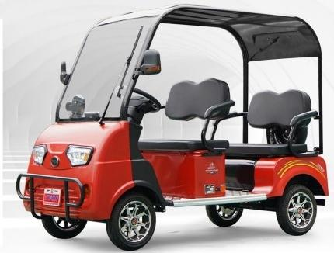
NWOW
Dear customers:
Thank you for choosing model EMC. Before practicing, please read carefully this
instruction book, and keep it well.We kindly request you to practice it according to local laws and traffic regulations.

